Slide 1

Vel Tech Rangarajan Dr. Sagunthala R&D Institute of Science and Technology
School of Computing
Department of Computer Science and Engineering
10211CS224 / FULL STACK APPLICATION DEVELOPMENT (JAVA)
PROJECT REVIEW : MILESTONE PROJECT – 1
Date: 23-03-2026
Academic Campus Event & Registration Portal
SDG: SDG 4 – Quality Education
Presented By:
I .MOHITH SAI VENKAT – VTU26456 – 23UECS0739
Courses Handling Faculty:
Dr. S . HEMAMALINI – M.E., Ph.D.,

Slide 2
INTRODUCTION
Background of the problem:
Campus events are managed manually, leading to paperwork, errors, and time consumption.
Why this project is important:
It automates event registration and management, reducing manual work and improving efficiency.
Real-world relevance:
Useful for colleges and institutions to manage technical, cultural, and academic events digitally.
Brief overview of the system:
A web-based portal where admin manages events and students register online.
1
2
3
4
5
6
7
8
9

Slide 3
PROBLEM STATEMENT
In many educational institutions, campus events are still managed manually or through basic systems that lack proper automation and centralized control. This results in excessive paperwork, difficulty in managing multiple events, errors in registration records, and challenges in tracking participant details efficiently. Manual processes consume time, increase administrative workload, and may lead to data loss or security issues. Therefore, there is a strong need for a secure, reliable, and fully automated web-based event management system that can streamline event creation, student registration, data storage, and tracking in an efficient and organized manner.
1
2
3
4
5
6
7
8
9

Slide 4
OBJECTIVES
1. To design and develop a secure web-based Academic Campus Event Portal for efficient event creation and management.
2. To implement an online student registration system with proper data storage and easy tracking of events and participants.
1
2
3
4
5
6
7
8
9

Slide 5
.
Admin can view and manage registered participants.
PROPOSED SYSTEM
The system is a web-based Academic Campus Event & Registration Portal.
2. It provides secure Admin and Student login authentication.
3. Admin can create, update, and delete events.
4. Students can view available events online.
5. Students can register for events through the portal.
6. All registration data is stored securely in a database.
7. Admin can view and manage registered participants.
8. It is faster and more efficient than manual systems.
1
2
3
4
5
6
7
8
9

Slide 6
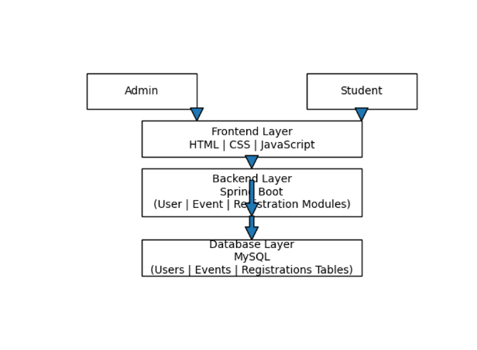
PROPOSED SYSTEM ARCHITECTURE
1
2
3
4
5
6
7
8
9

Slide 7
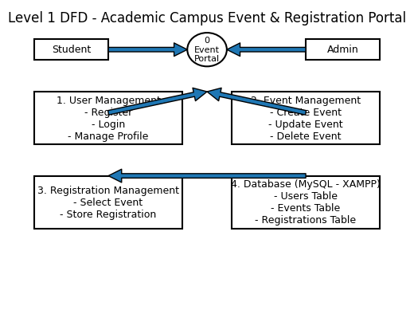
WORKFLOW
(Add dataflow diagram)
1
2
3
4
5
6
7
8
9

Slide 8
TECHNOLOGIES USED
Frontend:
1.HTML5
2.CSS3
3.Javascript
Backend:
1.Java Spring Boot
Database:
MySQL
Server:
XAMPP (Apache Server + MySQL)
Tools:
Web Browser (Chrome / Edge)
2. VS Code
1
2
3
4
5
6
7
8
9

Slide 9
MODULE DESCRIPTION
1
Module 1: User Management
This module handles Admin and Student registration, login authentication, and profile management to ensure secure access to the system.
Module 2: Event Management
This module allows the Admin to create, update, and delete events, manage event details such as date, description, and available seats.
Module 3: Registration Management
This module enables students to view available events and register online, while storing registration details securely in the database..
Module 4: Database Management
This module manages data storage using MySQL (via XAMPP), including Users, Events, and Registrations tables.
2
3
4
5
6
7
8
9

Slide 10
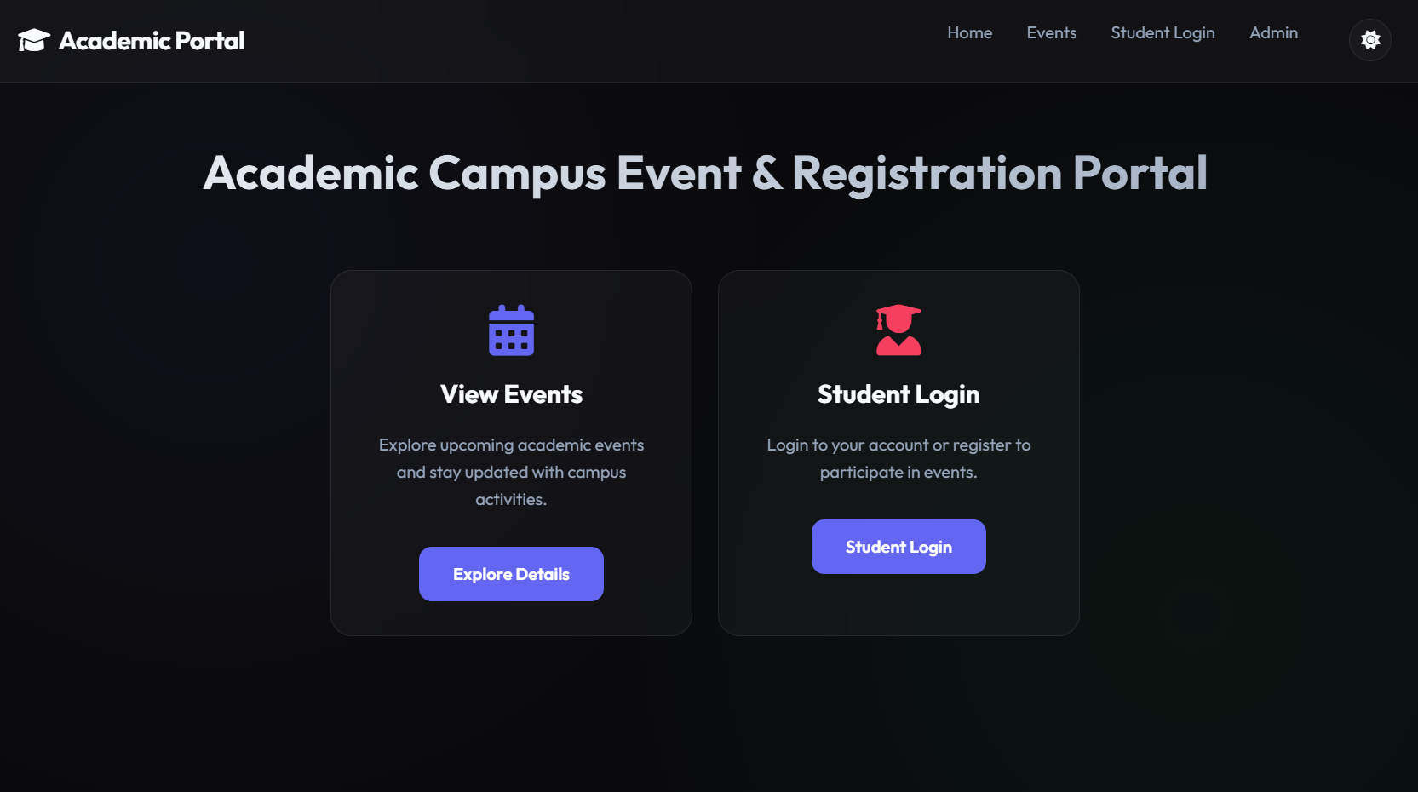
IMPLEMENTATION SCREENSHOTS
Login Page / Home Page:
1
2
3
4
5
6
7
8
9

Slide 11
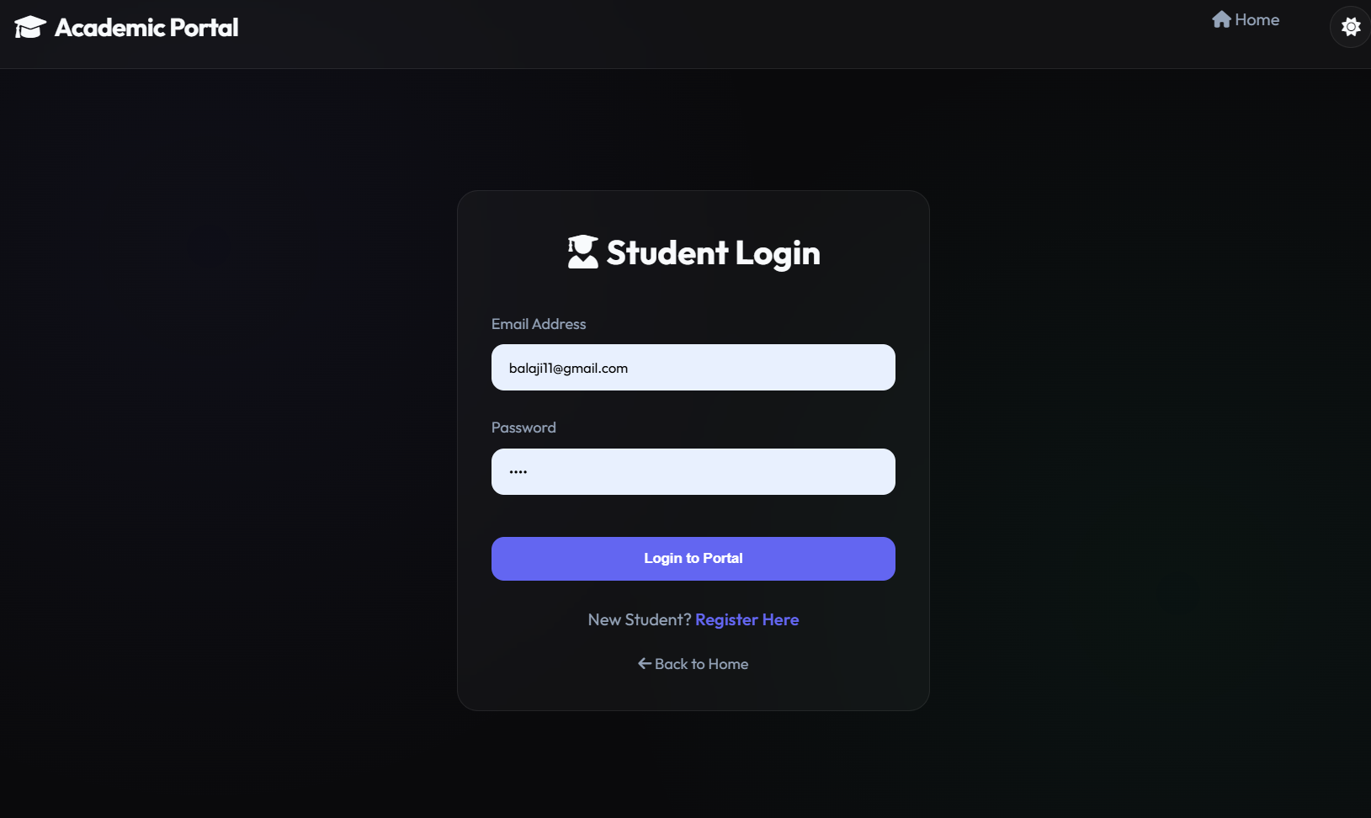
IMPLEMENTATION SCREENSHOTS
Student Login Page :
1
2
3
4
5
6
7
8(A)
9

Slide 12
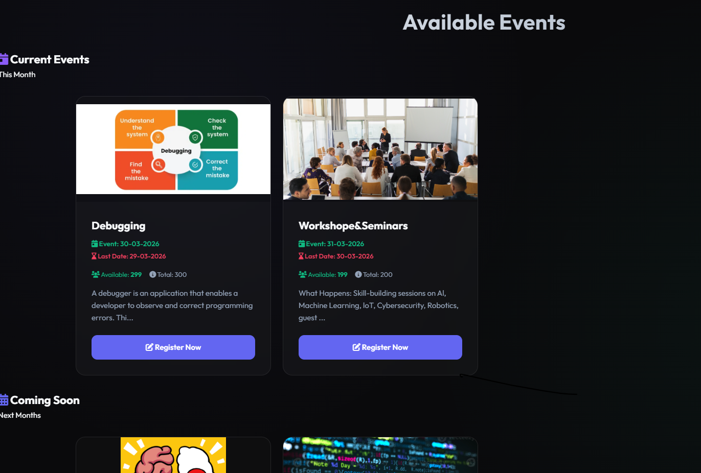
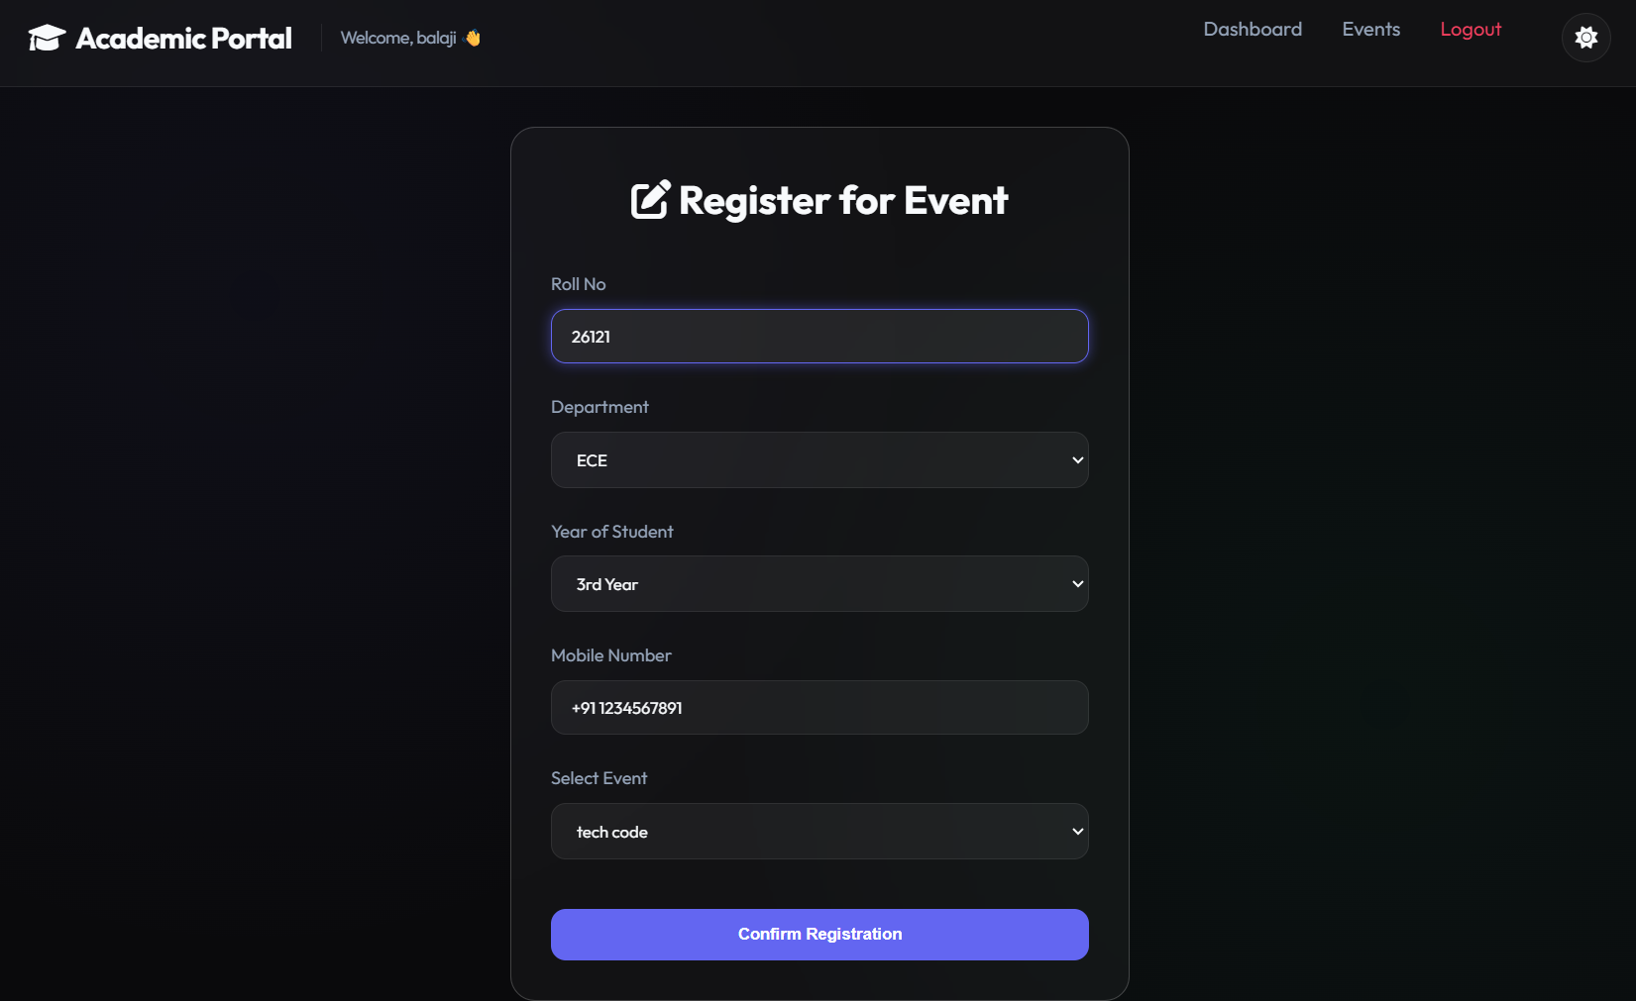
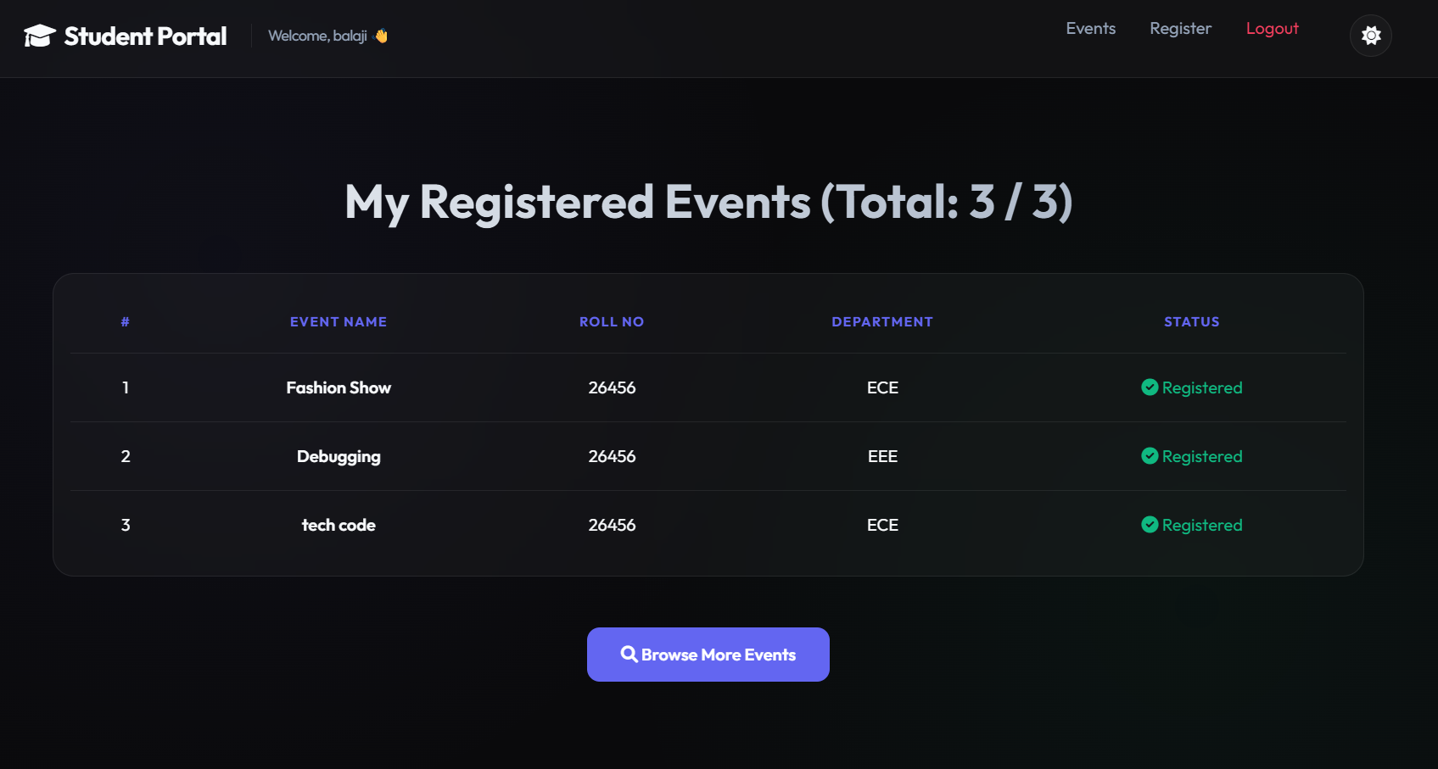
IMPLEMENTATION SCREENSHOTS
1
2
3
4
5
6
7
8(B)
9

Slide 13
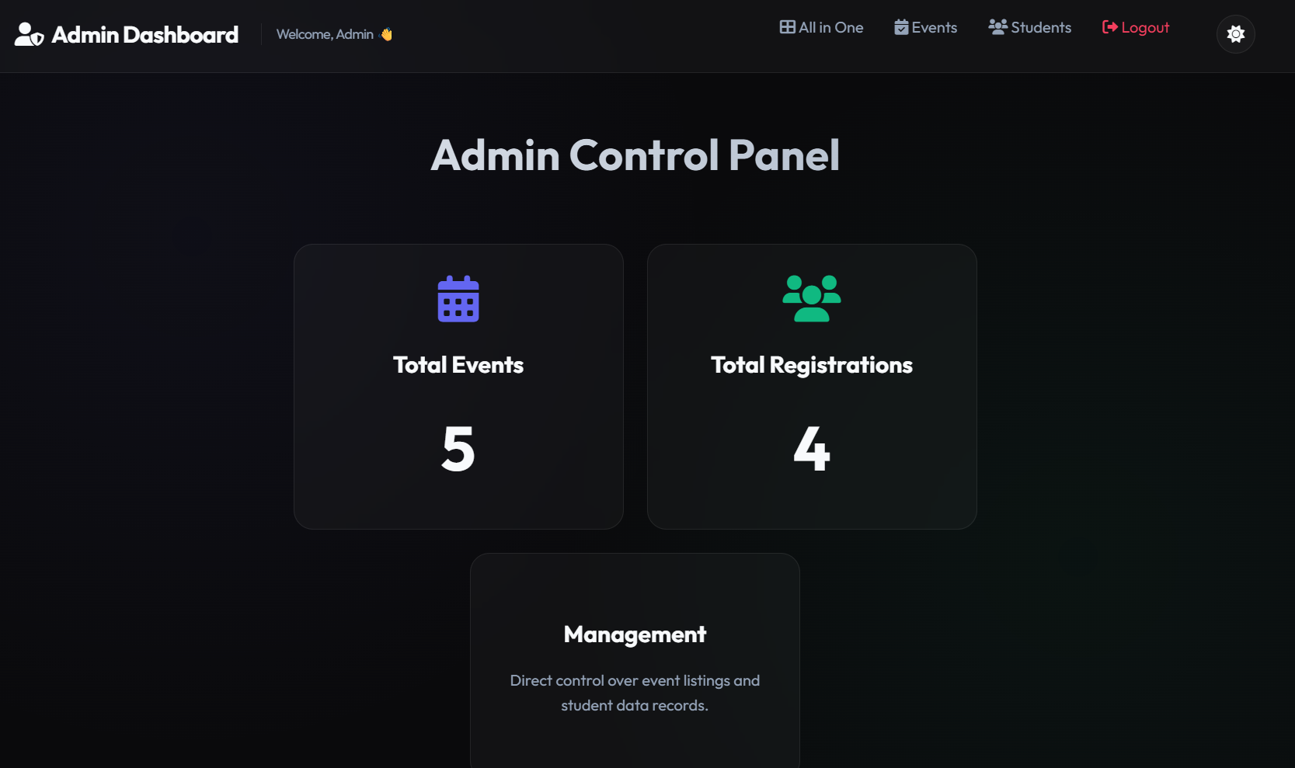
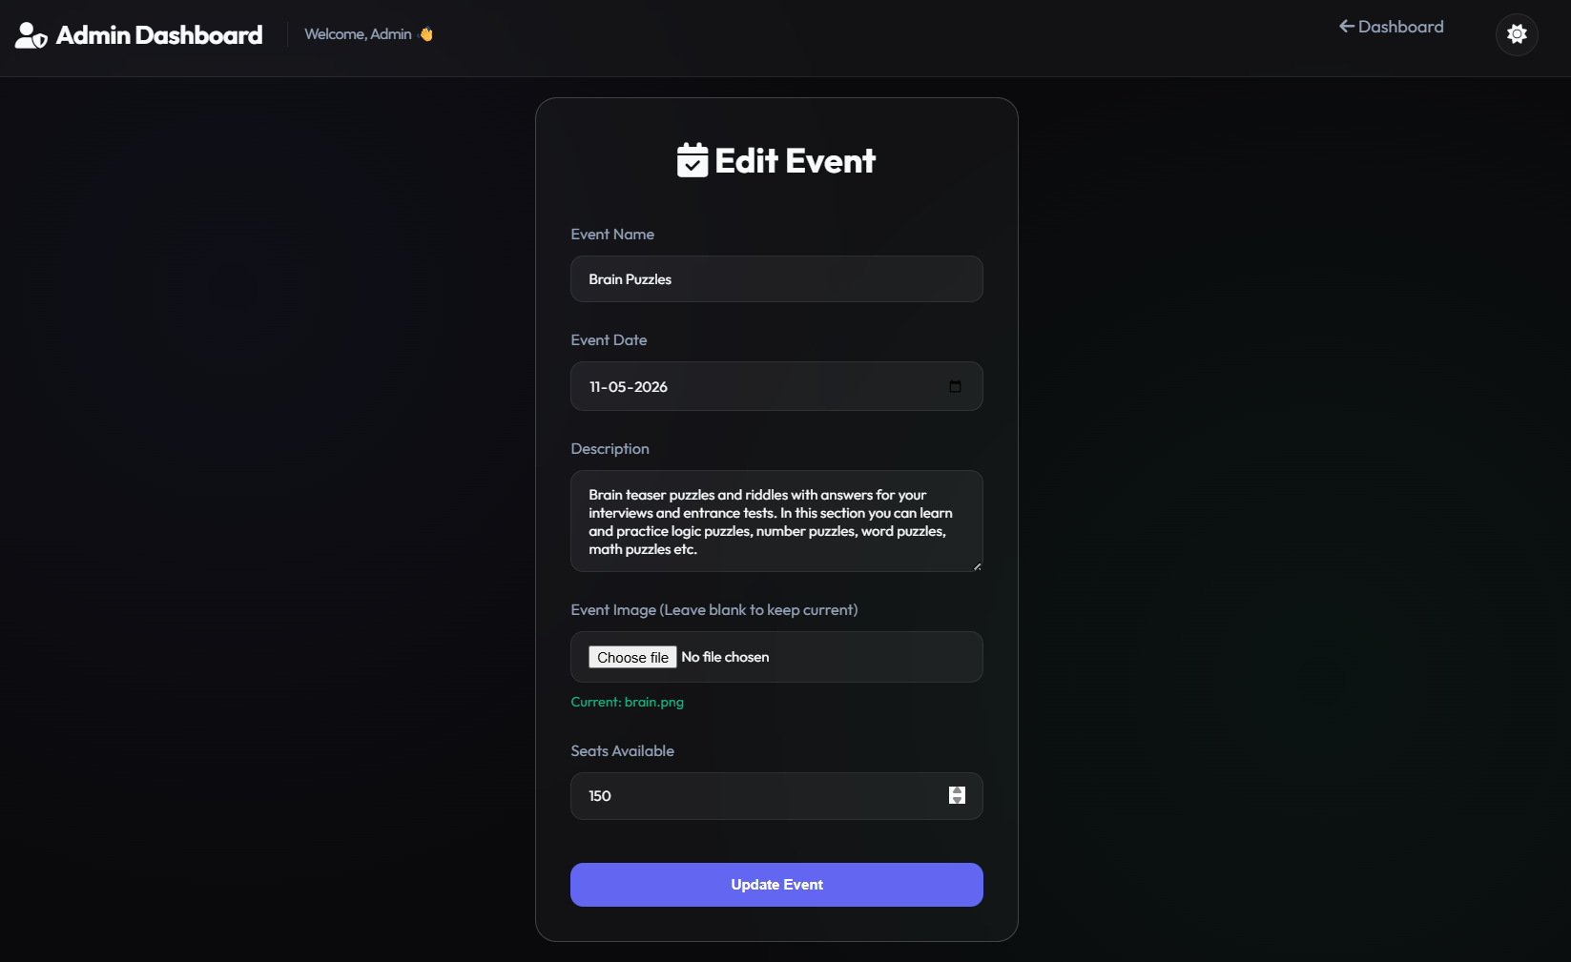
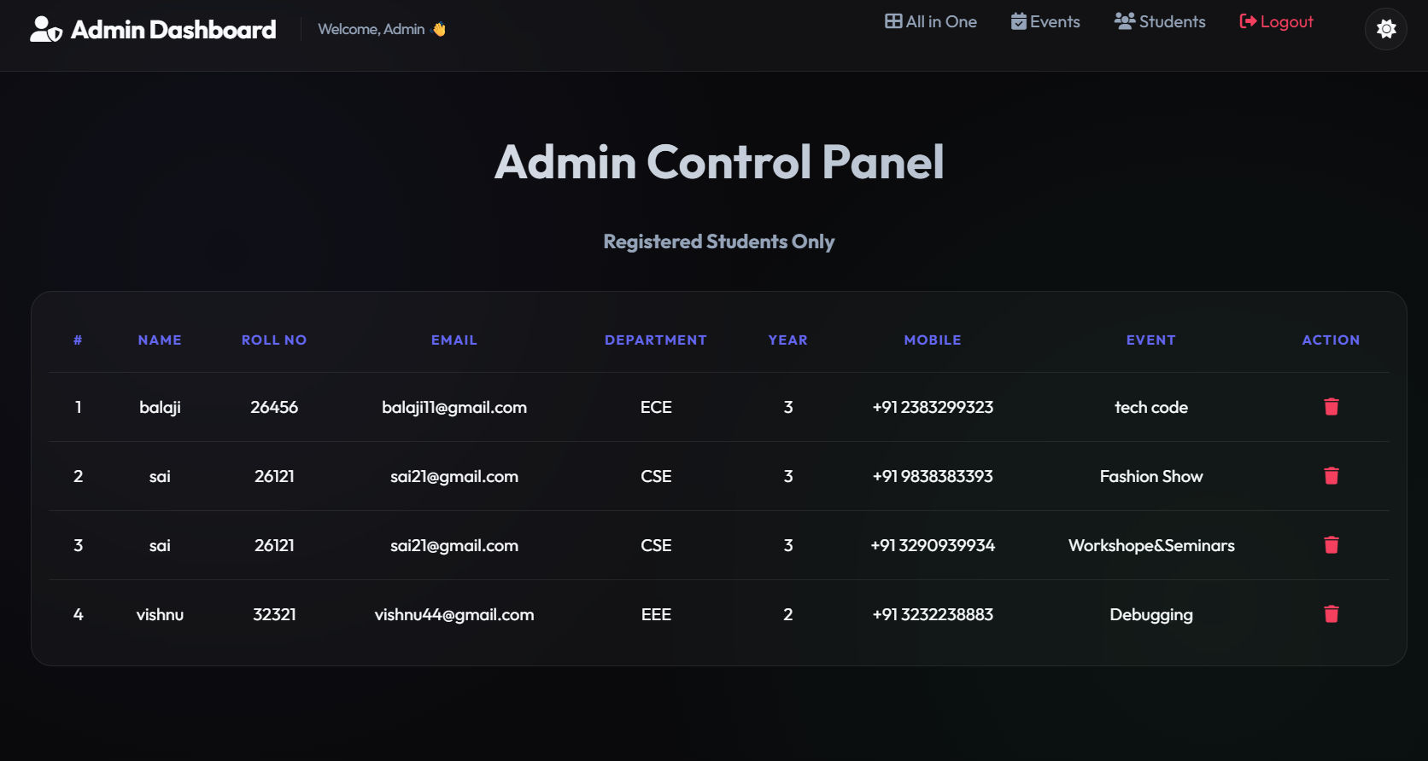
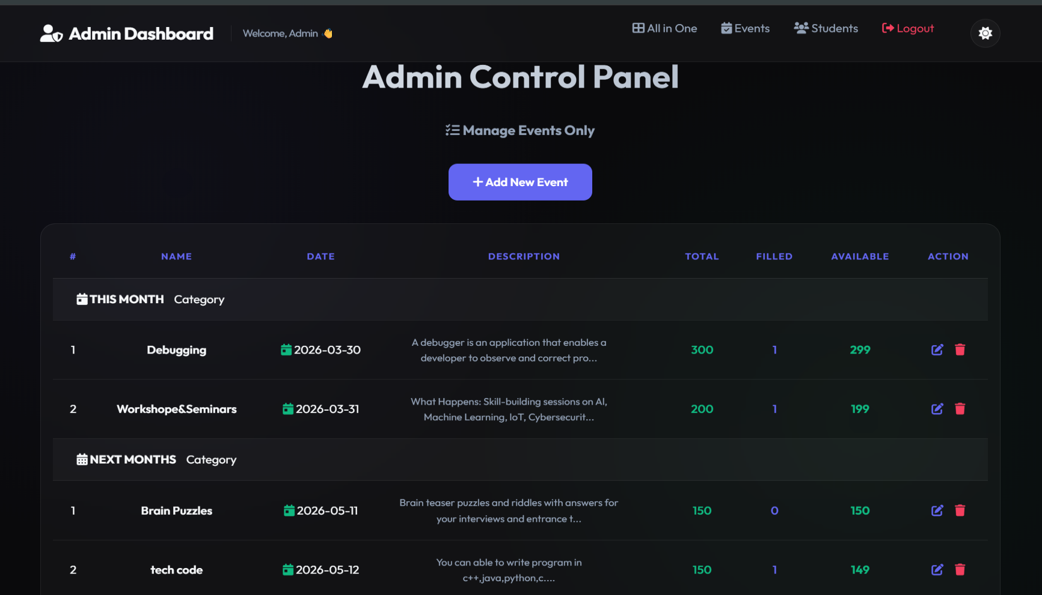
IMPLEMENTATION SCREENSHOTS
1
2
3
4
5
6
7
8(C)
9

Slide 14
ADVANTAGES & LIMITATIONS
Advantages:
Reduces manual paperwork and saves time
Provides centralized and secure event management.
3. Improves accuracy in storing and tracking registration data.
Limitations:
1. Requires continuous internet connection to access the portal.
2. Depends on XAMPP server availability for database access.
3. Limited to basic event management features.
4. Requires technical knowledge for maintenance and security configuration.
1
2
3
4
5
6
7
8
9

Slide 15
Thank you

